Slide 1
Precious Plastic
Keren Meron (India)
Ohad Beltzer
Yonatan Manor

Slide 2
Motivation

Slide 3
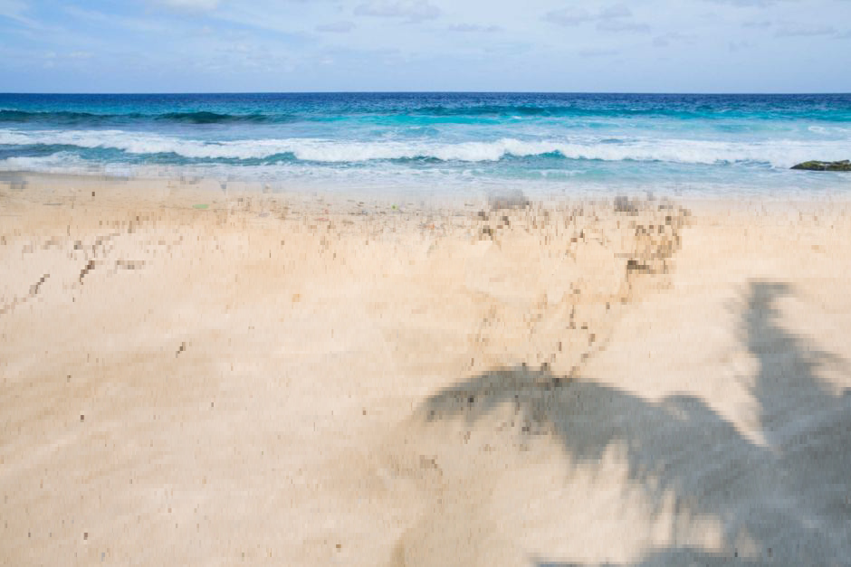
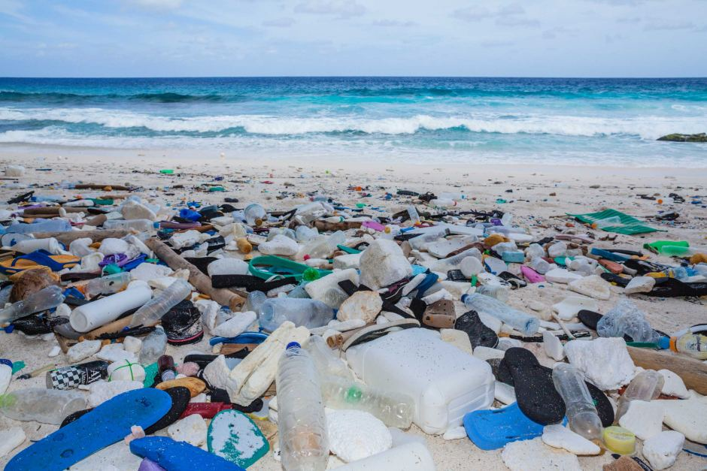
Motivation
There’s a problem we all know of:
Most of us ignore the problem, but if you look closely, you can see it all around

Slide 4
Motivation
Greta beach, Chistmas Island
The plastic problem is global
AUSTRAILIA

Slide 5
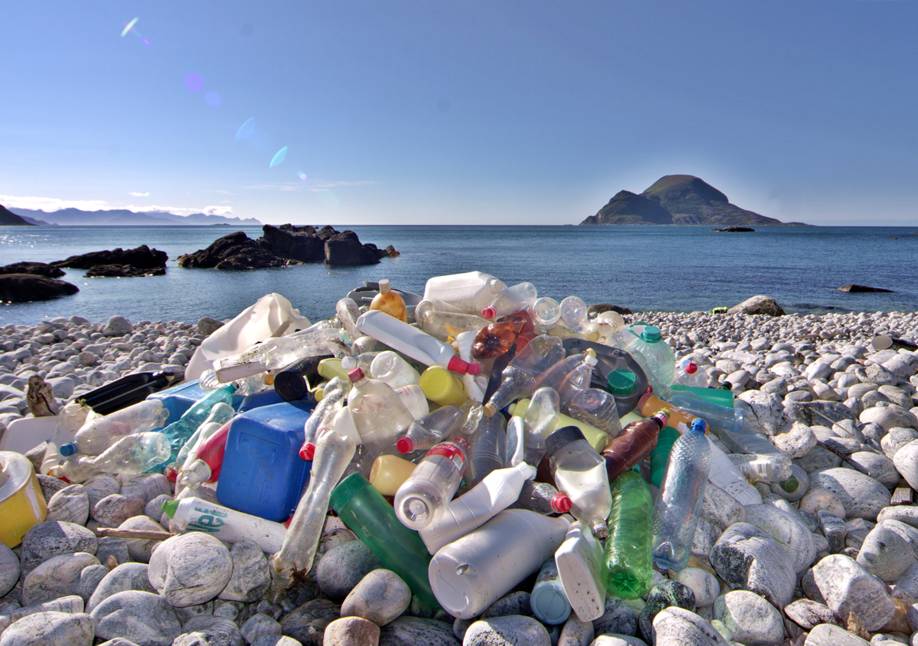
Motivation
The plastic problem is global
It’s here too...

Slide 6
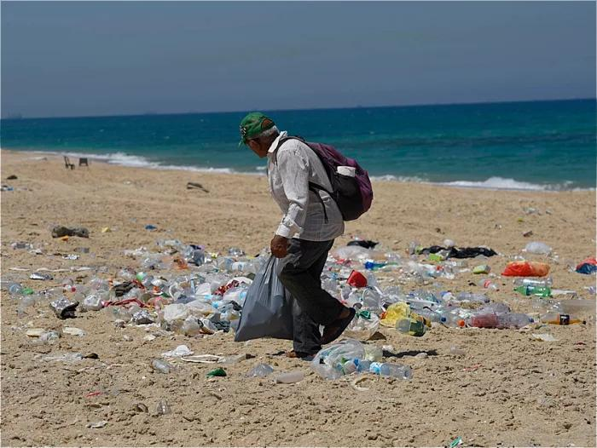
Motivation
Palmachim Beach
Israel
The plastic problem is global
It’s here too...
And here…

Slide 7
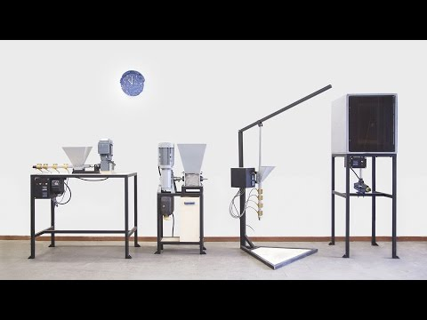
Motivation
So someone came up with
this idea:
This is where we come in
More info at www.preciousplastic.com

Slide 8
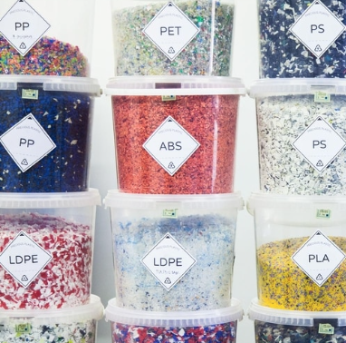
25,003
Currently
Members of the Precious Plastic Army are hoarding plastic flakes in their homes.

Slide 9

Meet the Precious
Plastic app
Your private plastic “bank account”
It’s recycling gamification
Buy real items with the points you acquire from recycling!
You can can report plastic wastes as Gold Mines for everyone to see
Designed by Dave

Slide 10
How does it work?
How about a demonstration...?

Slide 11
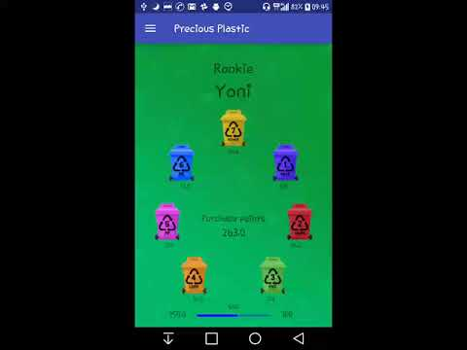
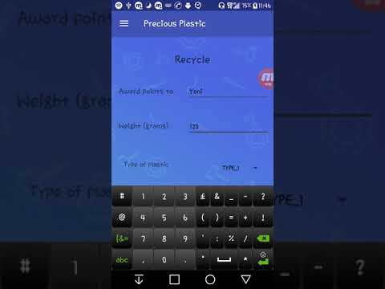
How does one get points?
By recycling of course!
Senior Yoni brings a bag of bottles to Senior Ohad to recycle
Senior Ohad recycles the plastic, giving Senior Yoni points
Yoni Receives Vid
Ohad Gives Vid
Notice Yoni’s title change?
He just leveled up!

Slide 12
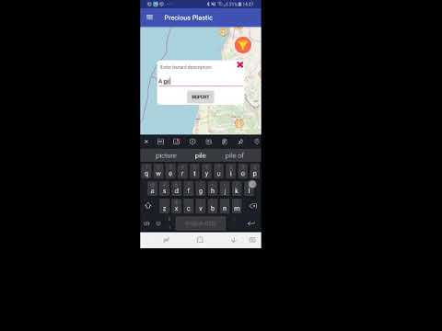
How does one report in the map?
Peter Parker is walking on the beach
Suddenly he sees a lot of plastic - AN OPPORTUNITY
Suddenly spiderman reports it in the
Precious Plastic app
Keren Reporting in India vid

Slide 13
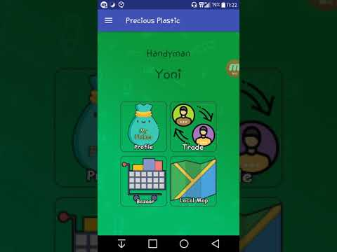
THIS IS AMAZING!
WHAT ELSE CAN I DO?
Browse the bazaar for inspiration like so:
If you have enough points,
you can buy it!
Vids
Like an item? Share it!

Slide 14
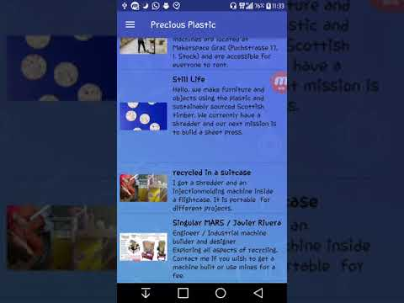
THIS IS AMAZING!
WHAT ELSE CAN I DO?
Browse the bazaar for inspiration like so:
Connect with other workspaces:
Click image to go communicate
Vids

Slide 15
THIS IS AMAZING!
WHAT ELSE CAN I DO?
Browse the bazaar for items like so:
Connect with other workspaces:
Did we mention leveling up?[we did]

Slide 16
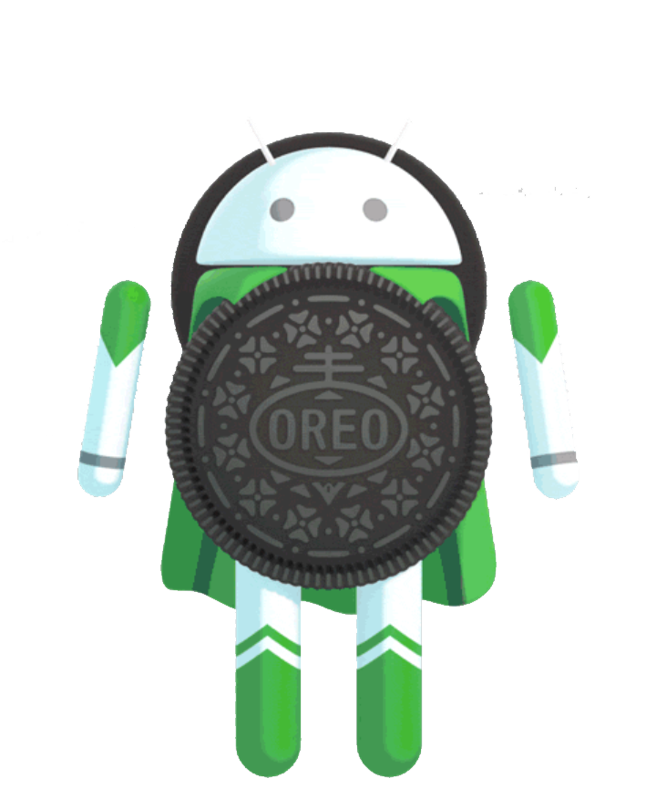
Plastic is
Worldwide
Plastic is recycled worldwide in factories.
It’s time to take recycling into our hands, and benefit from it.

Slide 17
Technical Description
Firebase-
Realtime DB .
Authentication
Realtime GUI (Callbacks)
REST
Service

Slide 18
Thanks!
Any questions?
Ohad.Beltzer@mail.huji.ac.il
Keren.Meron@mail.huji.ac.il Yonatan.Manor@mail.huji.ac.il

